Slide 1
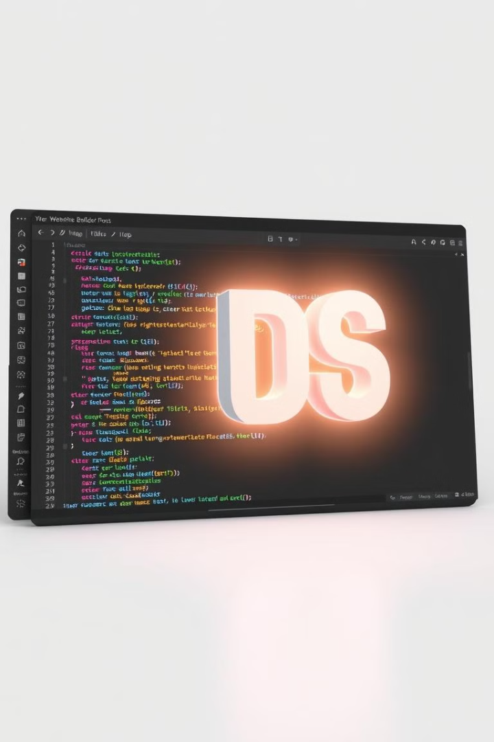

Introduction to Web Development
Welcome to the world of web development! This presentation will introduce you to the fundamental concepts and tools needed to build websites.
by Umang Mahajan

Slide 2
Front-End Development
Building the User Interface
Languages of the Web
Front-end development focuses on the visual aspects of a website. It involves creating the design, layout, and interactive elements that users see and interact with.
Front-end developers primarily use HTML, CSS, and JavaScript to bring websites to life. These languages work together to create the look, feel, and functionality of a web page.

Slide 3

HTML: The Structure of a Website
Building Blocks
Organizing Content
HTML (HyperText Markup Language) provides the basic structure for a website. It defines elements like headings, paragraphs, lists, and images.
HTML tags are used to define the content and layout of a web page, creating a hierarchical structure for organizing information.

Slide 4

CSS: Styling the Website
Controlling Appearance
Applying Styles
CSS styles are linked to HTML elements using selectors. They allow you to apply specific styles to different parts of a website, creating a consistent look and feel.
CSS (Cascading Style Sheets) is used to style the visual appearance of a website. It determines the colors, fonts, sizes, and overall layout of web page elements.

Slide 5



JavaScript: Adding Interactivity
Scripting Language
Enhancing the User Experience
JavaScript adds interactivity and dynamic behavior to websites. It allows you to create elements that respond to user actions, like clicking buttons or moving the mouse.
JavaScript can be used to implement features like animations, interactive forms, and dynamic content updates, creating a more engaging and responsive user experience.

Slide 6



Responsive Web Design
Adapting to Different Devices
Responsive web design ensures that a website looks and functions well across all devices, from desktops to tablets to smartphones.
Optimized User Experience
Responsive design techniques use CSS media queries to tailor the website's layout and content to different screen sizes and orientations, providing a seamless user experience regardless of device.

Slide 7



Web Development Tools and Frameworks
Code Editors
1
Visual Studio Code, Sublime Text, Atom.
Version Control
2
Git, GitHub.
Frameworks
3
React, Angular, Vue.js.

Slide 8

The Future of Web Development
Web development is constantly evolving. New technologies and approaches are emerging, pushing the boundaries of what's possible. The future promises exciting advancements in areas like artificial intelligence, virtual and augmented reality, and the Internet of Things, further shaping the web development landscape.

